Slide 1

Knapsack Problem
Consider the problem of filling a container (traditionally called a knapsack) with the highest value of goods you can carry.
Traditionally, the value is measured in dollars and the capacity of the knapsack is measured in weight.
This is a very clear analog of many, many problems of optimal selection of a subset of items.
http://www.geeksforgeeks.org/dynamic-programming-set-10-0-1-knapsack-problem/
There are various forms of the knapsack problem.
Some solvable by a greedy algorithm, others not

Slide 2
Fractional Knapsack problem
The goods you are trying to carry are infinitely divisible.
For instance, imagine you are trying to take fine-grained bulk foods like flour, sugar, oatmeal, etc.
You know the price per pound of each food.

Slide 3
0-1 Knapsack Problem
For each item, you can take exactly an integer number of items. You can’t divide it up the way you can flour and sugar.
Think cans of soup, frozen turkeys, etc.
There are two common varieties of the 0-1 Knapsack problem
You are only allowed to take one of any item (0-1 Knapsack without repetition)
You are allowed to take as many as you want of any item (assumes they are in infinite supply) (0-1 Knapsack with [infinite] repetition)
Notes:
Quiz questions 2-6

Slide 4
0-1 Knapsack with Repetition
Suppose K(w) is the maximum value of goods you can get into a knapsack of capacity w.
Our goal is to maximize K(w).
Suppose that the optimal solution contains an element of the i-th type of good, which has value v_{i} and weight w_{i}. Then
K(w) = K(w-w_{i}) + v_{i}
But we don’t know what item that was. However, we can check them all:
K(w) = max_{i} ( K(w-w_{i}) + v_{i} )

Slide 5
Knapsack again
This runs in time O(nW), so not really polynomial.
w (lower case w) is the granularity of the weights
If I weigh items to the nearest gram, the algorithm takes 1000 times longer than if I weigh items to the nearest kilogram
But if the weights are integers and there aren’t too many of them this is pretty fast.
“pseudopolynomial”
Clearly bottom-up dynamic programming
K(0) = 0
For w = 1 to W
K(w) = max_{i} ( K(w-w_{i}) + v_{i}), w_{i} ≤ w
return K(W)

Slide 6
Fractional Knapsack Problem
The goods you are trying to carry are infinitely divisible.
For instance, imagine you are trying to take fine-grained bulk foods like flour, sugar, oatmeal, etc.
You know the price per pound of each food.
Solvable by greedy algorithm. Greedy choice:
Take as much as possible of the most valuable item
Repeat until the knapsack is full
Notes:
Quiz questions 7-10

Slide 7
Fractional Knapsack: Greedy Choice
Claim: The Fractional Knapsack problem has the greedy choice property.
Proof outline:
Suppose not. Then there is an optimal loading of the knapsack that doesn’t take as much as possible of the most valuable item (call it M).
Take any weight of any item in the knapsack and replace it with any weight of M, and you have a more valuable knapsack.
Subtly different from the case for activity selection.
There there were multiple optimal solutions.

Slide 8
Fractional Knapsack: Optimal Substructure
Claim: The fractional knapsack problem has optimal substructure.
Proof outline:
Suppose the backpack has capacity W, and there are n items.
Consider the most valuable backpack of weight W.
If we remove weight w_{k} of item k, the remaining load must contain the optimal solution to a backpack of weight W-w_{k}, with all of the n-1 other items available and the weight W-w_{k}.
If not, the original load was not optimal.

Slide 9
Huffman Encoding
A simple compression system
Used in JPEG and MP3, but we illustrate with text.
Idea: Variable-length encoding
Encode common patterns with fewer bits, and uncommon patterns with more bits.
Code must be prefix-free:
No codeword can be the beginning of another codeword
So in decoding, whenever you find a codeword, you can spit out a character and start over looking for the next word.
Notes:
Quiz q1

Slide 10
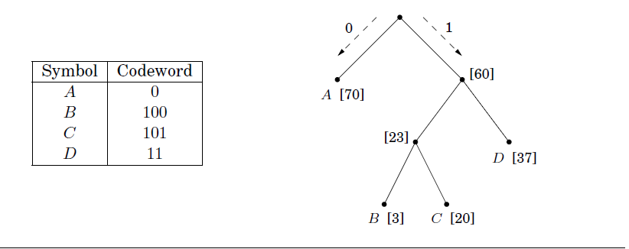
Prefix-free Code and Full Binary Tree
For a prefix-free code, every non-leaf node has two children. This makes it a “full binary tree”.
Notes:
Quiz q1

Slide 11
Building the Huffman Tree
Bottom up.
Take two smallest nodes, add their frequencies together, make a new node with these two as children
Do Huffman building algorithm again with the new internal node in place of its children.

Slide 12
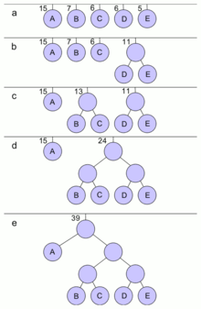
Building a Huffman Tree in Action
From Wikipedia

Slide 13
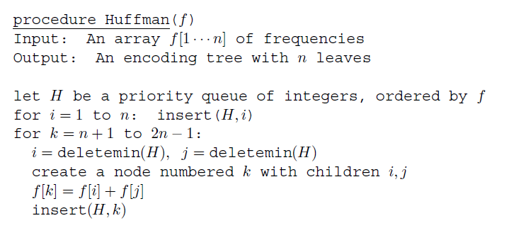
Huffman-building Pseudocode
Notes:
Do IC 2

Slide 14
Huffman Code
So we can build a tree like this, but is the greedy algorithm optimal? Must show
Greedy Choice property
Optimal substructure property
Theorem: The Huffman Coding algorithm shown produces an optimal prefix code.

Slide 15
Huffman Code – Greedy Choice Property
Lemma: Let C be an alphabet in which each character c∈C has frequency f[c]. Let x and y be the two characters in C having the lowest frequencies. Then there exists an optimal prefix code for C in which the codewords for x and y have the same length and differ only in the last bit.
In other words, making the greedy choice of combining the two lowest frequency characters permits an optimal solution.

Slide 16

Huffman Greedy Choice Proof Idea
Suppose that b and c are two characters that are sibling leaves of maximum depth.
There must be such a b and c, if there were not we could just move the one character up a level.
Since x and y are the two lowest frequency characters, we can swap b with x without increasing the cost of the tree
x had to be at the same or lesser depth as b
Similarly we can swap c with y
So some optimal tree has the two lowest-frequency characters as sibling leaves of maximal depth

Slide 17
Huffman Codes – Optimal Substructure
Lemma: Let T be a full binary tree representing an optimal prefix code over an alphabet C, where frequency f[c] is defined over each character c∈C.
Consider any two characters x and y that appear as sibling leaves in T, and let z be their parent.
Claim: Then, considering z as a character with frequency f[z] = f[x]+f[y], tree T’ = T-{x,y} represents an optimal prefix code for the alphabet C’ = C-{x,y}∪{z}.

Slide 18
Optimal Substructure Proof idea
Let B(T) be the cost of optimal tree T, and let B(T’) be the cost of the tree T’ with x and y replaced by their parent z.
Then B(T) = B(T’) + f[x] + f[y]
We add one unit of cost by expanding z to x or y
If T’ isn’t optimal, some tree T’’ must have B(T’’) < B(T’)
Z must be a leaf in T’’, since it’s a character of T’’.
So the cost of T’’ when we expand z is B(T’’)+f[x]+f[y]<B(t),
not possible because B(T) is optimal

